Slide 1
01 — SUMMER INTERNSHIP PROJECT
TITAN FITNESS
CENTER WEBSITE
Presented by: Abishek K · 810023205098
B.Tech Information Technology · University College of Engineering, BIT Campus, Anna University
Fantasy Solution, Trichy · Academic Year 2025–2026

Slide 2
02 — THE PROBLEM
A LOCAL GYM NEEDED ONE CLEAR DIGITAL FRONT DOOR
A responsive website turns scattered discovery into one place to understand, compare, and act.
1
2
BEFORE
AFTER
Information was difficult to find
One responsive website
Traditional promotion and direct inquiries made information difficult to find.
Services, plans, trainers, schedules, and contact come together in one place.
PROJECT GOAL
Create a modern, interactive, user-friendly platform for a fitness center.
Titan Fitness Center Website
2

Slide 3
03 — PROJECT ARC
The internship turned requirements into a working product
Analyze requirements and collect fitness-center content
Plan the page structure, colors, typography, and responsive behavior
Build reusable sections for navigation, hero, plans, programs, trainers, gallery, testimonials, FAQ, and contact
Add BMI calculation, WhatsApp, and click-to-call interactions
Test, optimize, document, and prepare the site for deployment
Titan Fitness Center Website
3

Slide 4





04 — TECHNOLOGY STACK
REACT AND THE WEB STACK FORMED THE IMPLEMENTATION BACKBONE
HTML5 + CSS3
JavaScript
React.js
Page structure, visual styling, and responsive layouts.
Validation, BMI calculation, navigation behavior, and interaction logic.
Reusable components and organized interface development.
Bootstrap
GitHub + Vercel
Responsive layout support and ready-to-use UI patterns.
Version control and deployment workflow.
Titan Fitness Center Website
4

Slide 5
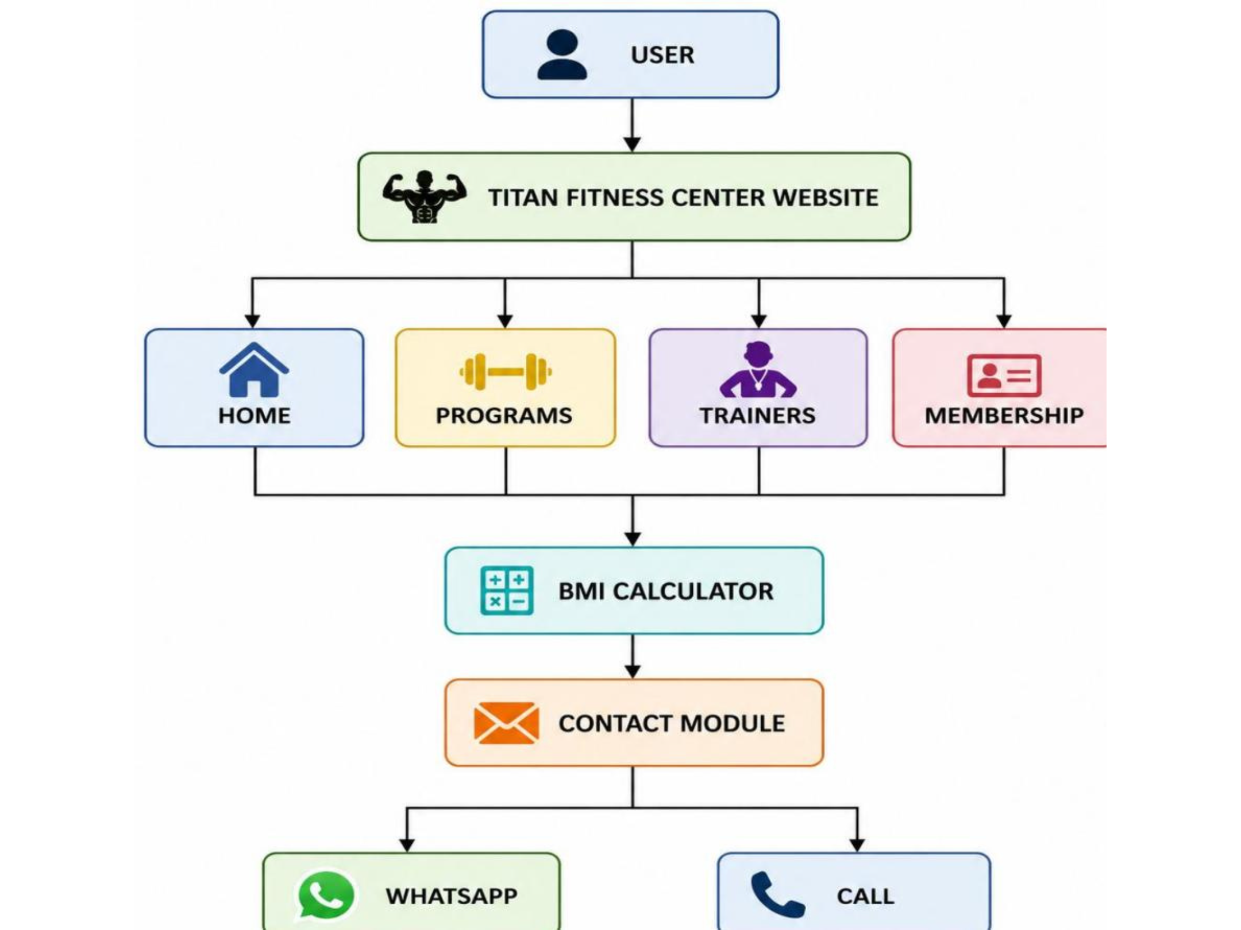
05 — PROPOSED SYSTEM
THE PROPOSED SYSTEM MAKES THE CUSTOMER JOURNEY EASIER TO ACT ON
Home and About: establish the gym’s identity and services
Programs and trainers: make the offer tangible and personal
Membership plans: present choices and benefits clearly
BMI calculator: give visitors an immediate interactive touchpoint
Contact: reduce friction through WhatsApp, phone, and inquiry options
Proposed system flowchart · supplied project evidence
Titan Fitness Center Website
5

Slide 6
06 — FEATURE SET
THE FEATURE SET BALANCES INFORMATION, MOTIVATION, AND CONVERSION
INFORM
MOTIVATE
Responsive home and about sections, membership plans with benefits and comparison points.
Fitness programs including weight loss, yoga, and CrossFit, supported by trainer profiles, workout schedules, gallery, testimonials, and FAQs.
CONVERT
Direct communication through WhatsApp and click-to-call.
Titan Fitness Center Website
6

Slide 7

07 — INTERACTIVE FEATURE
THE BMI CALCULATOR TURNS A STATIC PAGE INTO A USEFUL TOOL
A simple interaction creates a starting point for a fitness conversation.
01
02
03
04
FORMULA
Enter
Validate
Calculate
Display
Enter height and weight.
Validate the input values.
Apply BMI = weight ÷ height².
Display the calculated value and health category.
05
Continue
Use the result as a starting point for a fitness conversation.
Titan Fitness Center Website
7

Slide 8
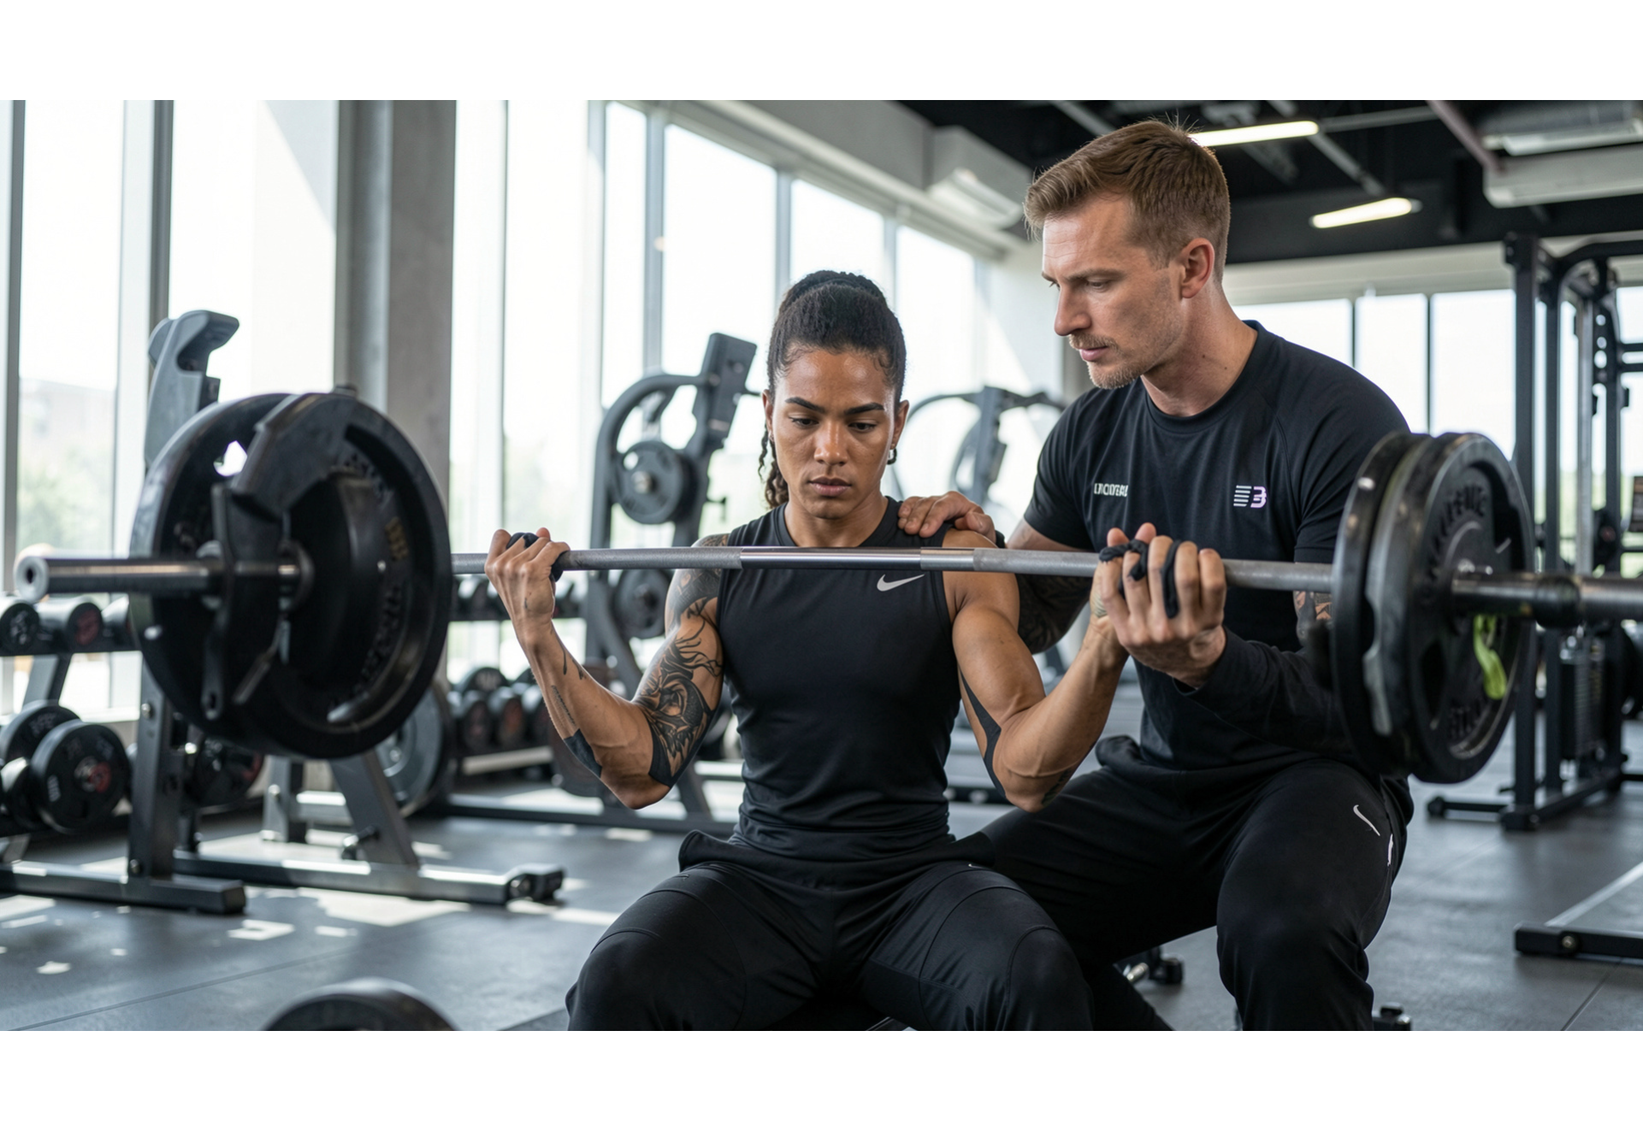
08 — IMPLEMENTATION WORKFLOW
IMPLEMENTATION FOLLOWED A REUSABLE, TESTABLE WORKFLOW
Set up the React project and component structure.
Build navigation, hero, plans, programs, trainers, and contact sections.
Implement BMI logic and communication actions.
Refine responsive layouts and browser compatibility.
Optimize images, manage the GitHub repository, and deploy through Vercel.
Titan Fitness Center Website
8
Website implementation evidence · supplied project screenshot

Slide 9
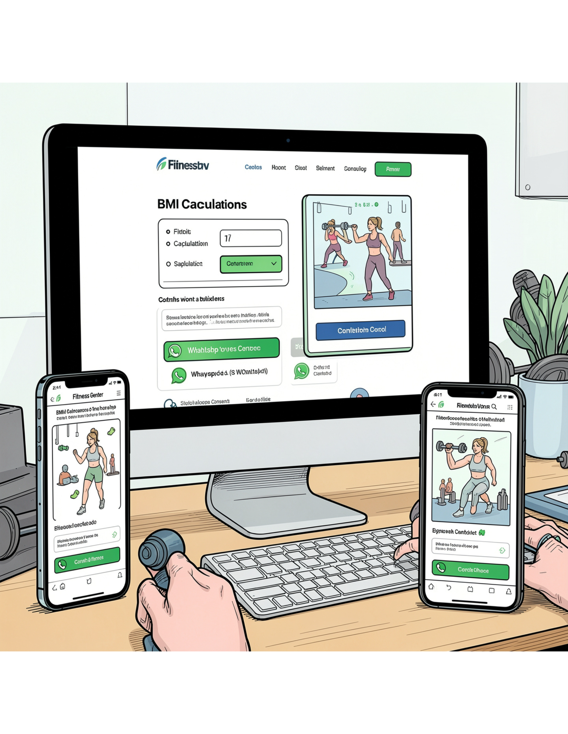
09 — VALIDATION
TESTING CONFIRMED THE PROJECT’S PRACTICAL VALUE
Functionality
Responsiveness
Navigation, BMI validation, calculation, WhatsApp, and click-to-call.
Layout checks across desktop, tablet, and mobile screens.
Performance
Result
Image optimization and loading improvements.
A professional, accessible, and scalable online presence for Titan Fitness Center.
Titan Fitness Center Website
Result evidence · supplied project screenshot
9

Slide 10
10 — CLOSING OUTLOOK
THE FOUNDATION IS READY FOR THE NEXT LAYER OF FITNESS SERVICES
DELIVERED
SKILLS STRENGTHENED
FUTURE SCOPE
A responsive and interactive fitness-center website.
React.js, HTML, CSS, JavaScript, UI/UX, GitHub, testing, and deployment.
Login and registration, online payments, admin dashboard, MongoDB integration, workout tracking, and trainer booking.
Thank you · Questions?
Titan Fitness Center Website
10

